Slide 1
APPLICATION FUNDAMENTALS
GROUP 6
NANDINI
10/4/2018

Slide 2
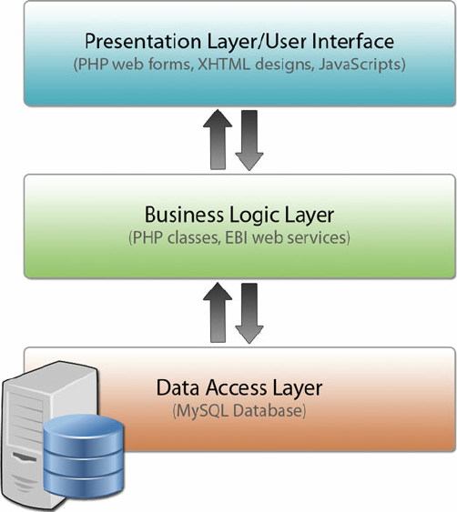
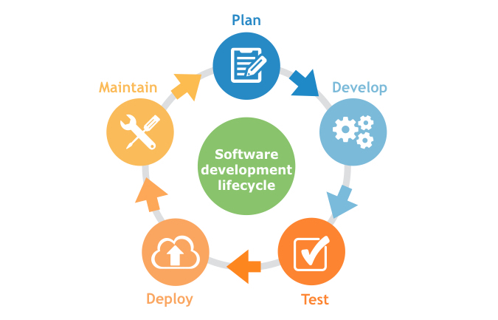
APPLICATION
Application is a program designed to perform a group of coordinated functions, tasks, or activities for the benefit of the user.
Components of Application:
Life cycle of application:

Slide 3

APPLICATION
Types of Application:
Compiled
Interpreted
Application Programming Interface:
An application program interface (API) is code that allows two software programs to communicate with each other.
Application security:
Application security is the use of software, hardware, and procedural methods to protect applications from external threats.
Attacks:
SQL injection
Cross-Site Scripting Attacks
Denial of Service
Session Hijacking/Cross Site Request Forgery(CSRF)
Counter measures:
Using stored procedures with parameters that are automatically parameterized.

Slide 4
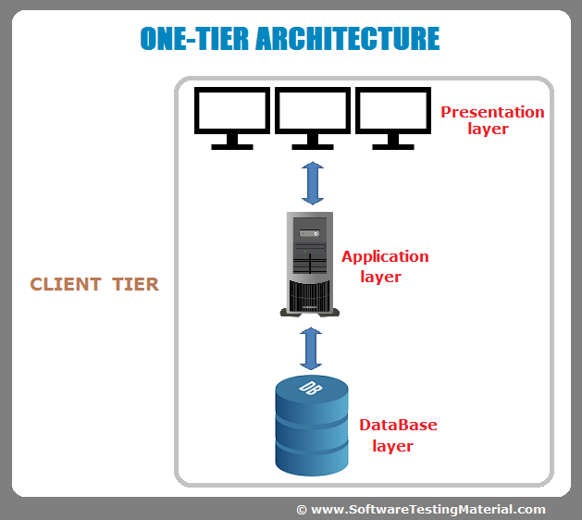
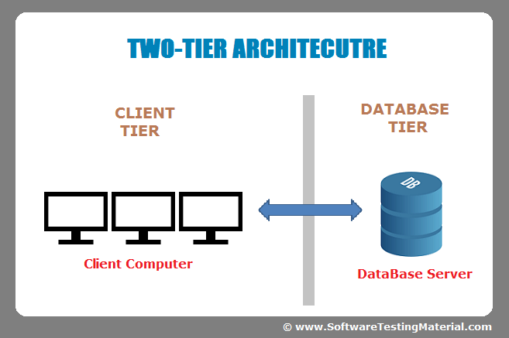
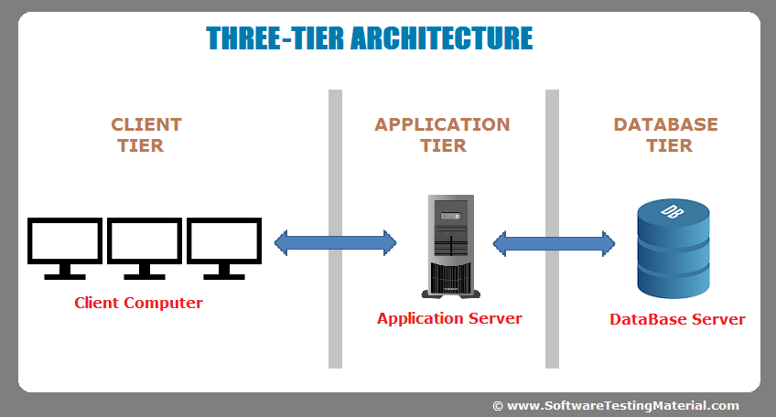
APPLICATION ARCHITECTURE
Thick client architecture
Thin client architecture
Rich internet application
TIER:
Enterprise Applications

Slide 5
STORAGE FUNDAMENTALS
GROUP 6
NANDINI
10/4/2018

Slide 6
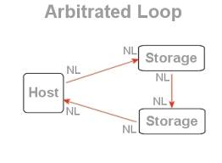
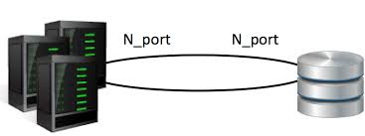
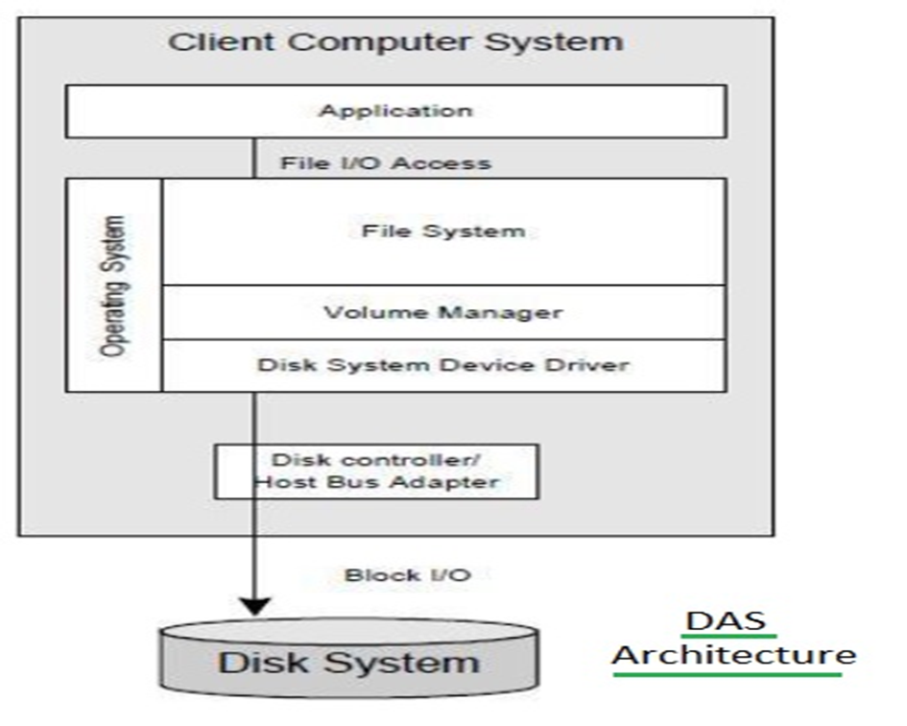
STORAGE
Storage is a process through which digital data is saved within a data storage device by means of computing technology.
Fiber channel:
FC Point to Point
FC Arbitrated Loop
Storage Model:
Direct Attached Storage (DAS)

Slide 7
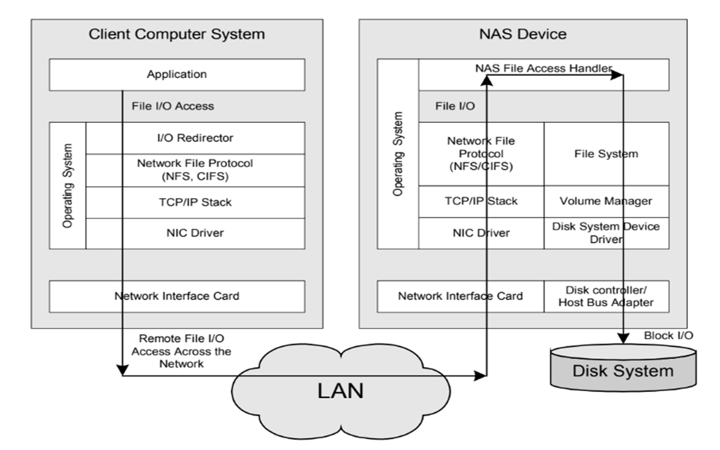
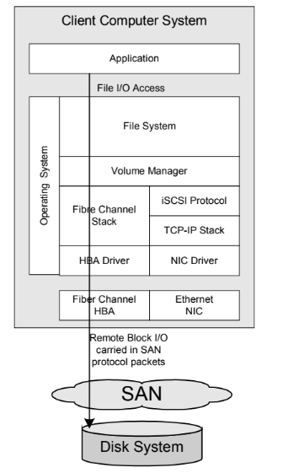
TYPES OF STORAGE
Network Attached Storage (NAS) Storage Area Network(SAN)

Slide 8
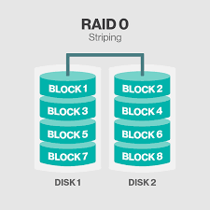
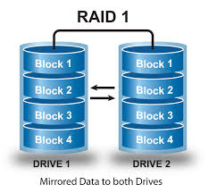
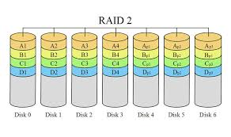
RAID(REDUNDANT ARRAY OF INEXPENSIVE DISKS) LEVELS
Basic idea is to connect multiple disks together to provide large storage capacity, faster access to reading data and redundant data
RAID Level-0
RAID Level-1
RAID Level-2

Slide 9
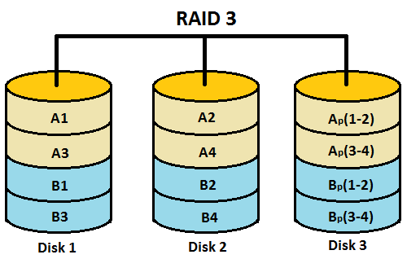
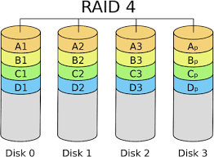
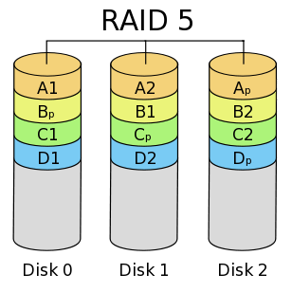
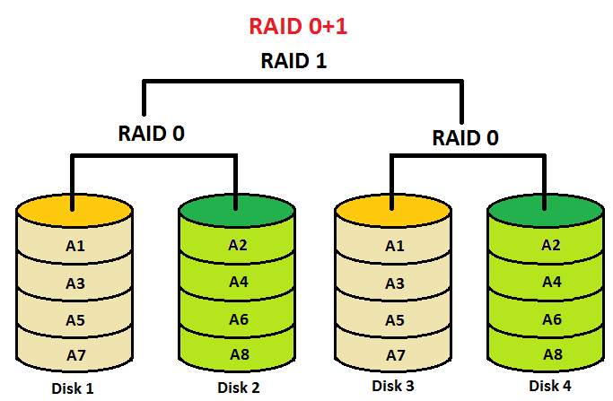
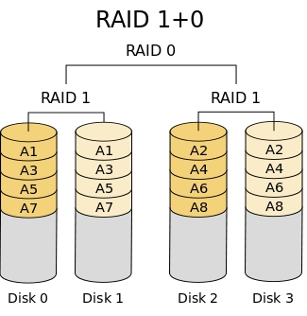
RAID Level-3
RAID(REDUNDANT ARRAY OF INEXPENSIVE DISKS) LEVELS
RAID Level-4
RAID Level-5
RAID Level- 1+0 & 0+1

Slide 10
THANK YOU

